Slide 1

Baywheels
San Francisco, CA

Slide 2


Slide 3


Slide 4
Distribution
When and Where to distribute
End/Start stations and daily ride quantity
Dock capacity & EOD bike counts
Maintenance
Time of year best to perform full maintenance tune-ups
Trip duration and ride count
Models
Bicycle options
User type and trip length categories

Slide 5
Summary
AVG monthly rides per year:
2017
2018
2019
74,242.9
155,310.1
208,915.3
Rides per year:
2017
2018
2019
519,700
1,863,721
2,506,983
WITH
all_years AS
(SELECT *
FROM baywheels_2017
UNION
SELECT *
FROM baywheels_2018
UNION
SELECT *
FROM baywheels_2019),
monthly_rides AS
(SELECT DATE_TRUNC('month', start_time) as year_month, COUNT(*) as monthly_count
FROM all_years a
GROUP BY 1
ORDER BY 1)
SELECT DATE_PART('year', year_month) as year, ROUND(AVG(monthly_count), 1) as avg_monthly_rides
FROM monthly_rides m
GROUP BY 1
ORDER BY 2 DESC;
Time Frame:
2.5 years
June 28, 2017 – December 31, 2019
SELECT DATE_PART('year', start_time), COUNT(*) count_all_rides
FROM
(SELECT *
FROM baywheels_2019
UNION
SELECT *
FROM baywheels_2018
UNION
SELECT *
FROM baywheels_2017) as all_years
GROUP BY 1
ORDER BY 1;
SELECT to_char(DATE_TRUNC('day', MIN(start_time)), 'yyyy-mm-dd') as first_day,
to_char(DATE_TRUNC('day', MAX(start_time)), 'yyyy-mm-dd') as last_day
FROM
(SELECT *
FROM baywheels_2017
UNION
SELECT *
FROM baywheels_2018
UNION
SELECT *
FROM baywheels_2019) as all_years;
AVG daily rides per year:
2017
2018
2019
2,779.1
5,106.1
6,868.4
Total number of rides:
4,890,404
Number of bikes:
12,301
Number of stations:
421
SELECT COUNT(*) count_all_rides
FROM
(SELECT *
FROM baywheels_2019
UNION
SELECT *
FROM baywheels_2018
UNION
SELECT *
FROM baywheels_2017) as all_years;
SELECT COUNT(DISTINCT bike_id)
FROM
(SELECT *
FROM baywheels_2017
UNION
SELECT *
FROM baywheels_2018
UNION
SELECT *
FROM baywheels_2019) as full_years
ORDER BY 1;
SELECT COUNT(DISTINCT id)
FROM baywheels_stations;
SELECT DATE_PART('year', year_day) as year, ROUND(AVG(daily_count), 1) as avg_daily_rides
FROM (
SELECT DATE_TRUNC('day', start_time) as year_day, COUNT(*) as daily_count
FROM (
SELECT *
FROM baywheels_2017
UNION
SELECT *
FROM baywheels_2018
UNION
SELECT *
FROM baywheels_2019) as all_years
GROUP BY 1
ORDER BY 1) as monthly_rides
GROUP BY 1;

Slide 6
Distribution

Slide 7
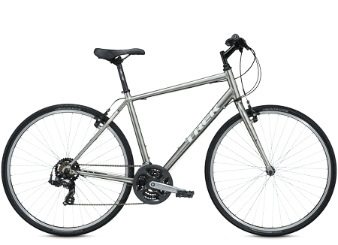
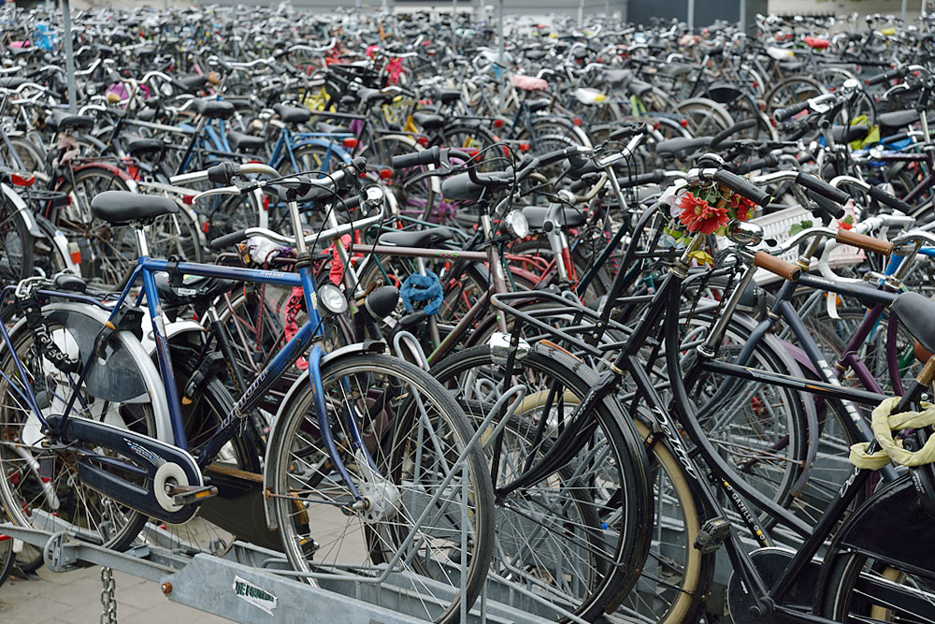

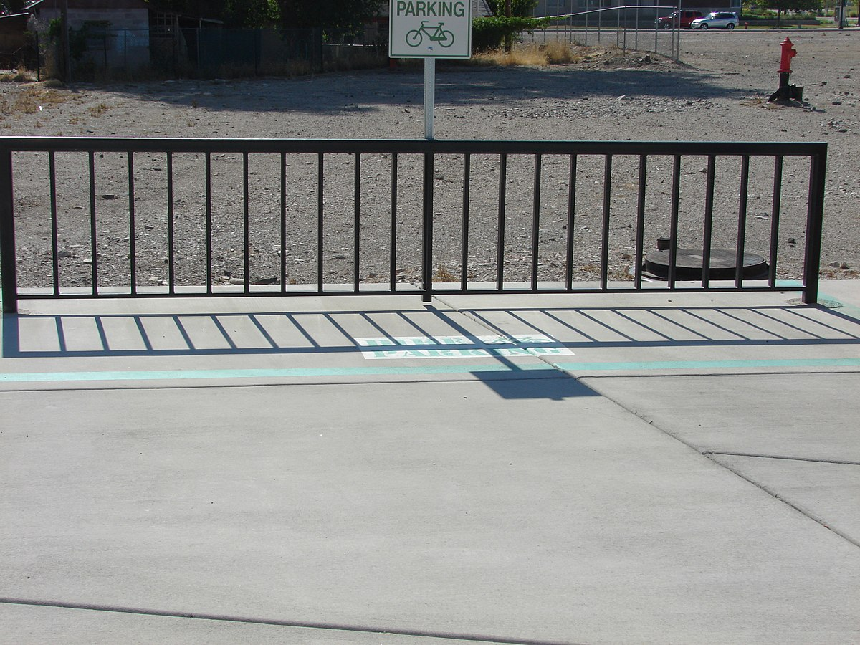
For each station, what is the difference in ending bike count and starting bike count?
WITH
start_station AS (
SELECT b9.start_station_id, COUNT(*) AS ride_count, bs.docks
FROM baywheels_2019 b9
JOIN baywheels_stations bs
ON b9.start_station_id = bs.id
GROUP BY 1, 3
ORDER BY 2 DESC),
end_station AS (
SELECT b9.end_station_id, COUNT(*) AS ride_count, bs.docks
FROM baywheels_2019 b9
JOIN baywheels_stations bs
ON b9.end_station_id = bs.id
GROUP BY 1, 3
ORDER BY 2 DESC)
SELECT s.start_station_id as station_id, s.ride_count start_ride_count,
e.ride_count end_ride_count,
(e.ride_count - s.ride_count)/365 as eod_end_minus_start_ride,
e.docks, e.docks - (e.ride_count - s.ride_count)/365 as
eod_docks_minus_bike_count
FROM start_station s
JOIN end_station e
ON s.start_station_id = e.end_station_id
ORDER BY 4 DESC;
--Thanks for the help Claudia! (cte layout & joining)
(-)
station_id | start_ride_count | end_ride_count | docks | eod_end_minus_start_ride | eod_docks_minus_bike_count
21 | 36081 | 47886 | 37 | 32 | 5
30 | 40302 | 50943 | 18 | 29 | -11
15 | 39016 | 48180 | 36 | 25 | 11
6 | 28785 | 33286 | 17 | 12 | 5
350 | 16127 | 19984 | 31 | 10 | 21
93 | 21437 | 25046 | 26 | 9 | 17
176 | 12943 | 15913 | 31 | 8 | 23
364 | 9847 | 10215 | 29 | 1 | 28
317 | 4043 | 4488 | 18 | 1 | 17
8 | 10514 | 10721 | 23 | 0 | 23
12 | 3379 | 3284 | 21 | 0 | 21
387 | 1240 | 623 | 18 | -1 | 19
146 | 2906 | 1989 | 12 | -2 | 14
70 | 9730 | 6350 | 31 | -9 | 40
369 | 7829 | 4013 | 25 | -10 | 35
71 | 7920 | 3895 | 27 | -11 | 38
343 | 14810 | 10733 | 25 | -11 | 36
253 | 8237 | 3835 | 23 | -12 | 35
52 | 7802 | 3082 | 24 | -12 | 36
256 | 11236 | 6792 | 13 | -12 | 25
243 | 17302 | 8149 | 29 | -25 | 54
More docks
hour_of_day | number_of_rides
0 | 75
1 | 43
2 | 28
3 | 14
4 | 18
5 | 70
6 | 270
7 | 741
8 | 1486
9 | 1157
10 | 601
11 | 567
12 | 634
13 | 621
14 | 592
15 | 685
16 | 1034
17 | 1580
18 | 1235
19 | 751
20 | 480
21 | 339
22 | 228
23 | 136
Highest activity by Time of Day
SELECT DATE_PART('hour', start_time), COUNT(*)/365
FROM
(SELECT *
FROM baywheels_2019
UNION
SELECT *
FROM baywheels_2018
UNION
SELECT *
FROM baywheels_2017) as all_years
GROUP BY 1
ORDER BY 1;

Slide 8
Conclusion
Patrol 2x daily just after peak hours 8-10am and 4-7pm to redistribute bikes from stations with positive eod bike activity to stations with negative eod bike activity
Add docks to station 30.
Start_ride_count/dock capacity suggests we resupply bikes at least that many times per day or add docks. If start_rides early, we don’t know when bikes will return and starting with, at most, dock capacity.

Slide 9
Maintenance

Slide 10


Best time of year for full tune-ups and routine maintenance
How much time is accrued on each bike 2019?
WITH
two_years AS
(SELECT *
FROM baywheels_2018
UNION
SELECT *
FROM baywheels_2019)
SELECT
CASE
WHEN DATE_PART('month', start_time) = 1 THEN 'January'
WHEN DATE_PART('month', start_time) = 2 THEN 'February'
WHEN DATE_PART('month', start_time) = 3 THEN 'March'
WHEN DATE_PART('month', start_time) = 4 THEN 'April'
WHEN DATE_PART('month', start_time) = 5 THEN 'May'
WHEN DATE_PART('month', start_time) = 6 THEN 'June'
WHEN DATE_PART('month', start_time) = 7 THEN 'July'
WHEN DATE_PART('month', start_time) = 8 THEN 'August'
WHEN DATE_PART('month', start_time) = 9 THEN 'September'
WHEN DATE_PART('month', start_time) = 10 THEN 'October'
WHEN DATE_PART('month', start_time) = 11 THEN 'November'
WHEN DATE_PART('month', start_time) = 12 THEN 'December'
ELSE '' END AS month, COUNT(*) as number_of_rides
FROM two_years t
GROUP BY 1
ORDER BY 2 DESC;
--Only used 2 years (2018 / 2019) because 2017 is incomplete
month | number_rides
July | 457324
October | 441353
September | 404203
August | 402725
June | 387740
April | 370280
March | 367681
May | 361288
November | 319631
February | 290130
January | 286884
December | 281465
SELECT bike_id, AGE(end_time, start_time) as
trip_duration
FROM baywheels_2019
ORDER BY 2 DESC
LIMIT 10;
bike_id | trip_duration
614329 | 10 days 13:21:50
11724 | 23:57:10
3260 | 23:56:58
11475 | 23:55:15
845 | 23:55:14
3370 | 23:52:32
12549 | 23:52:16
1393 | 23:51:45
9826 | 23:48:23
1007 | 23:47:57
How many rides per bike id 2019?
SELECT bike_id, COUNT(*) as count_rides
FROM baywheels_2019
GROUP BY 1
ORDER BY 2 DESC
LIMIT 10;
bike_id | count_rides
3135 | 912
3146 | 911
3569 | 889
3249 | 882
1502 | 882
3009 | 874
1406 | 871
2174 | 866
2293 | 862
2692 | 862
Conclusion:
Winter time, December/January should be time for full tune-ups and maintenance
Bikes should be brought in for inspection and quick maintenance after 450 rides or 12 hours

Slide 11
Models
(bike types)

Slide 12

What types of trips did our users complete in 2019?
Customers vs. Subscribers
SELECT user_type,
CASE
WHEN AGE(end_time, start_time) >= '00:00:00' AND AGE(end_time, start_time) < '00:30:00' THEN 'Short'
WHEN AGE(end_time, start_time) BETWEEN '00:30:00' AND '01:00:00' THEN 'Medium'
WHEN (end_time - start_time) > '01:00:00' AND (end_time - start_time) < '02:00:00' THEN 'Long'
WHEN (end_time - start_time) >= '02:00:00' THEN 'Super long'
ELSE ''
END AS trip_duration_category, COUNT(start_time) as ride_count
FROM baywheels_2019
GROUP BY 1, 2
HAVING COUNT(start_time) > 10
ORDER BY 2, 3 DESC;
trip_length | user_type | number_of_rides | difference | ratio
Long | Customer | 14,027 | +8,741 | 2.65
Long | Subscriber | 5,286
Medium | Customer | 40,858
Medium | Subscriber | 47,296 | +6,438 | 1.16
Short | Customer | 422,691
Short | Subscriber | 1,965,568 | +1,542,877 | 4.65
Super long | Customer | 8,234 | +5,222 | 2.73
Super long | Subscriber | 3,012
Conclusion
Different types of bikes to suit ride type and user
Road - Subscribers
Touring - Customers
Electric – chillers
Scooters – quick trips

Slide 13
What next? How to improve data base?
Running total of bike availability at each station
Tracking bikes leaving / arriving in real time
Collect more data
Collect data on type of bikes being ridden by adding field/column to data tables for future rides
Odometer/speedometer
Issues reported
Ratings and user experience

Slide 14
Thank You

